Slide 1
Computer Science 3A
Practical 7
15 April 2021

Slide 2
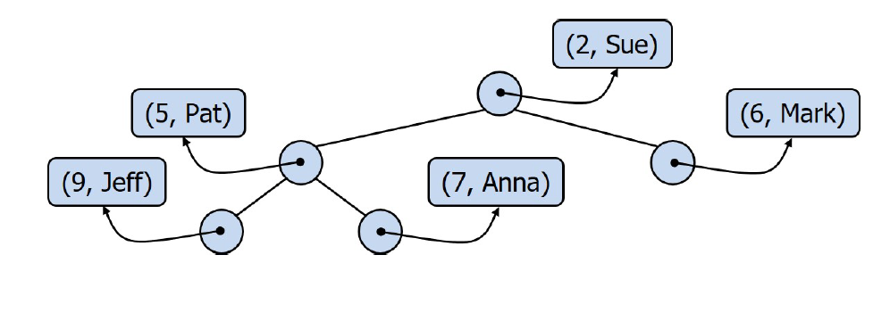
Heap
Heap-order property:
key(v) >= key(parent(v))
CSC3A10 Practical 7

Slide 3
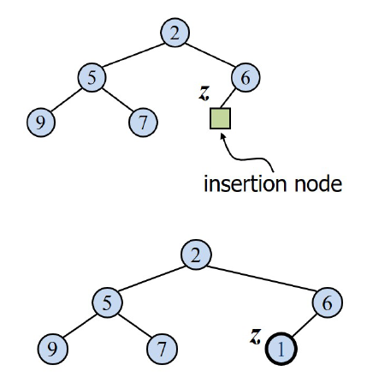
Heap Insertion
CSC3A10 Practical 7

Slide 4
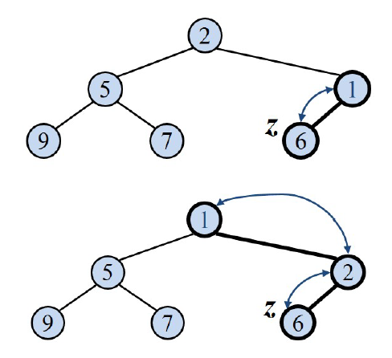
Upheap
CSC3A10 Practical 7

Slide 5
Upheap Algorithm:
Upheap (node):
-If node is the root: return
-If node’s value > parent’s value: return
-Swap the parent and the node
-Recursive call: Upheap (node.parent())
CSC3A10 Practical 7

Slide 6
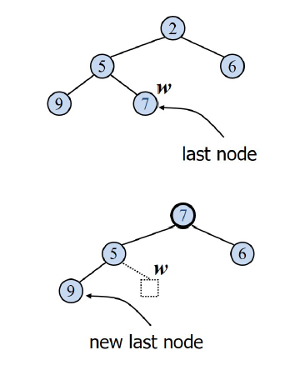
Heap Removal
CSC3A10 Practical 7

Slide 7
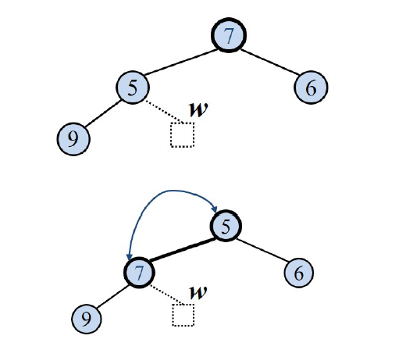
Downheap
CSC3A10 Practical 7

Slide 8
Downheap Algorithm:
Downheap (node):
-If node’s children are null: return
-Determine which child is smaller (hint: use compareTo method)
-If node’s value is less than smallerChild: return
-Swap the node with the smaller child
-Recursive call: Downheap (smallerChild)
CSC3A10 Practical 7

Slide 9
GetLastNodeInsert:
Algorithm provided on the assignment
* Opposite of GetLastNodeRemove
CSC3A10 Practical 7

Slide 10
Priority Queue: RemoveMin
removeMin
Create a Heap <K, Entry <K,V>>
Go through each entry in the positionList
Insert each of them into the heap
Perform a list.remove on the determined Entry with highest priority (hint: make use of the list’s search() together with the heap’s removeMin() method)
CSC3A10 Practical 7

Slide 11
Main:
allocateInternsWithPriorityQueue (PQtasks, Interns[] )
-while there are tasks in the Queue:
get the Entry with highest priority: removeMin()
Go through the interns:
WorkCompleted = workCompleted+workRate
EnergyLevel = energy - workrate
If workCompleted/workTotal is 100%: print completed
If energylevel >0: print energy level
otherwise move on to the next intern
CSC3A10 Practical 7

